Slide 1

Field education
MSW Field Students
Part 1
School of Social Work and Family Sciences

Slide 2
Graduate student Field Contact Person
MSW Field Coordinator – Overall Field Contact
Monica Ascar, MSW, LISW-S
mascar@uakron.edu
Phone: 330-515-0600
Each campus has a member of the Field Education team​ that you may contact as needed:
Graduate Main & Stark
Rob Terry, MSSA, LISW-S
Polsky 410
Phone: 330-972-8790
Email: rpterry@uakron.edu
Graduate Wayne
Mark McManus, Ph.D., MSSW
Wayne C134
Phone: 330-972-5213
Email: mcmanus@uakron.edu
Graduate Lakewood
Monica Ascar, MSW, LISW-S
A131, Lakewood Campus
Phone: 330-515-0600
Email: mascar@uakron.edu

Slide 3

Overview Agenda
Signature Pedagogy
Field Education Structure
Generalist Perspective
Social Work Applications
Interview Process Tips
This Photo by Unknown Author is licensed under CC BY-SA-NC
School of Social Work and Family Sciences

Slide 4



Signature Pedagogy is Field Education
Represents the central form of instruction and learning in which a profession socializes its students to perform the role of practitioner
`
School of Social Work and Family Sciences

Slide 5
Signature Pedagogy is Field Education
In addition to social work, other professions use this as a foundation of professional socialization:​
Medicine​
Law​
Education
School of Social Work and Family Sciences

Slide 6
Field Education Structure and Expectations
School of Social work and Family Sciences

Slide 7
Field Education Structure and expectations for MSW
Grade structure – Pass or Fail​ (Credit or No Credit​)
No Credit or Fail = repeat field education​
Credit = Pass​
1 min hour of weekly supervision with field instructor​
1 Required visit by Faculty Field Liaison per semester
School of Social Work and Family Sciences

Slide 8
Field Education Structure and expectations for MSW
Two consecutive semesters​
Generalist (Foundation) students
  Must complete 200 hours per semester- 16 hours per week​
Specialist (Concentration) students
  Must complete 250 hours per semester- 17 hours per week
3 credit hours per semester for field education
School of social work and family sciences

Slide 9
Field Education Structure and expectations: Generalist (Foundation) Year
Two consecutive semesters​
Field begins at the start of the semester
Generalist (Foundation)-Full-time Student
  1st year-1st placement​
Generalist (Foundation) – Part-time Student
  2nd year – 1st placement
School of social work and family sciences

Slide 10
Field Education Structure and expectations: Specialist (Concentration) Year
Two consecutive semesters​
Field begins at the start of the semester
Specialist (Concentration)-Full-time Student
  2nd year- 2nd placement​
Specialist (Concentration) – Part-time Student
  4th year – 1st placement
Specialist (Concentration) Advanced Standing
  1 year program – 1 field placement only
School of social work and family sciences

Slide 11

Field Education Structure and expectations for MSW
ENGAGE
ASSESS
INTERVENE
EVALUATE
CORE SOCIAL WORK SKILLS

Slide 12
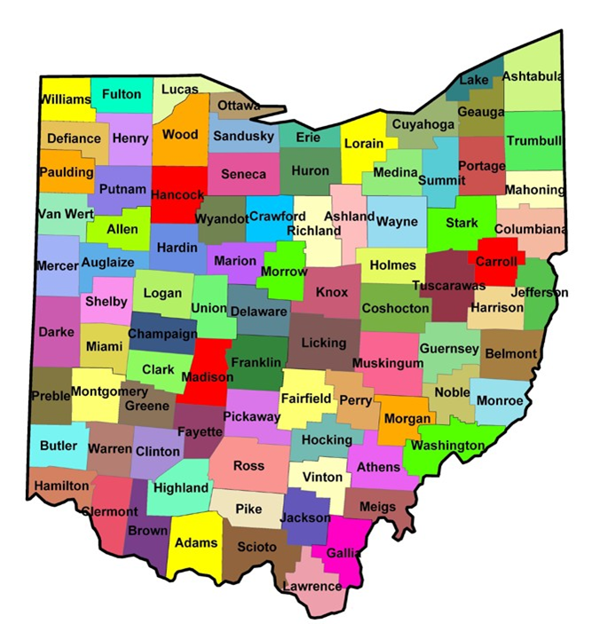

Generalist practice
GENERALIST PRACTICE
School of social work and family sciences

Slide 13
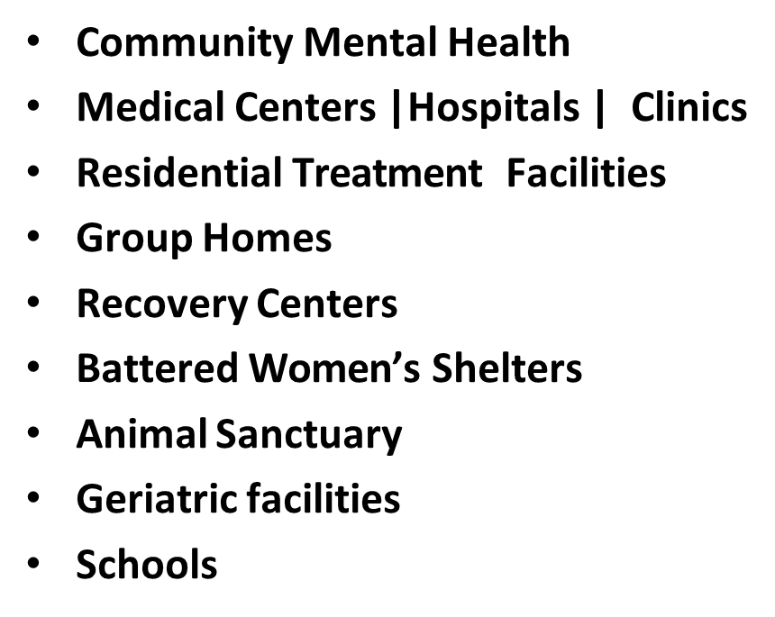
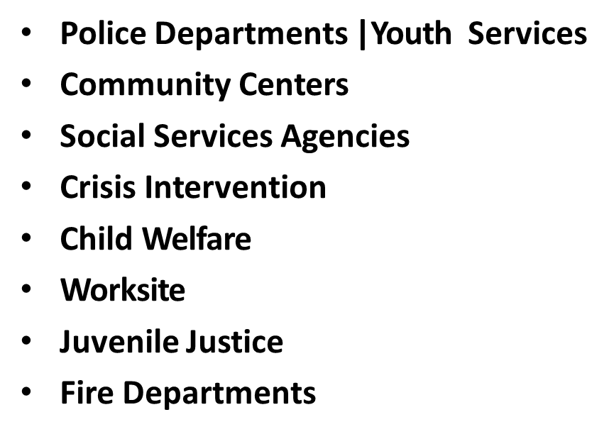
Field AGENCY Sites
School of social work and family science

Slide 14


Micro/ Macro
School of Social Work and Family Sciences

Slide 15


Micro and macro client systems
Micro Client system –individual, family, small group- problems solving| case-based research
Macro Client system- organizations, neighborhoods, community development, administration, policy development/ implementations, program research
Ability to Engage
Ability to Assess
Ability to Intervene
Ability to Evaluate
School of Social Work and Family Sciences

Slide 16
Potential Practice Areas and Target Populations
Target Audience
Target Population
Aging/Gerontology​
Alcohol, Drug, or Substance Abuse​
Child Welfare​
Community Planning​
Criminal | Juvenile Justice & Corrections​
Developmental Disabilities​
Domestic Violence| Crisis Intervention​
Family Services​
Group Services
Health| Community Health | Hospice​
Housing Services​
International​
Mental Health | Community Health​
Occupational​
Rehabilitation​
School Social Work
School of social work and family science

Slide 17
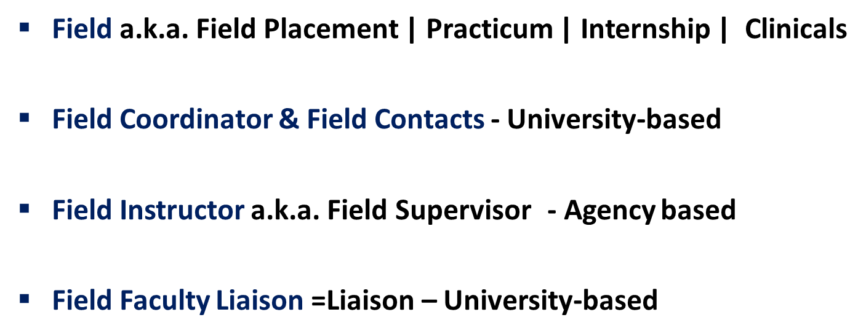
Field education terminology
School of Social Work and Family Sciences

Slide 18
Securing your field placement
School of Social Work and Family Sciences

Slide 19

Securing your field placement
Review field section of social website- https://www.uakron.edu/socialwork/field-education/
Review deadline for required application materials
Field Placement must be secured prior to start of semester (failure to do so will delay start of field)
School of Social Work and Family Sciences

Slide 20
Placement forms and process
Second set of required forms are due after student completes interviews and selects agency (should be submitted NO later than one week prior to the start of the field semester)
3. Agency Acceptance form – completed by agency
4. If needed: completed FAPE Proposal with appropriate signatures
Application packet should be submitted to the MSW Field Coordinator within two weeks of being assigned field orientation access:
MSW Field Application Packet
Orientation Pre-placement Part 1 Signature page
School of Social Work and Family Sciences

Slide 21
Field placement at place of employment (fape)
Required completion of a proposal
Field Instructor separate person from Employment Supervisor
Field Placement & Employment hours may be the same or separate dependent on agency policy and the ability to link work tasks to competencies.
Field Instructor = MSW/MSSA/MSSW + 2 years of post – educational experience and at least 1 year with employment agency
School of Social Work and Family Sciences

Slide 22

Securing a field placement
Visit Agency Roster - https://www.uakron.edu/socialwork/agency-search.dot
Review different agencies based upon areas of practice or location interests
Begin contacting agencies of interest to arrange interview
Be sure to also review the MSW Field Manual and Syllabus for your particular field course
School of Social Work and Family Sciences

Slide 23
Interview Process
School of Social Work and Family Sciences

Slide 24


Contacting potential field agency
School of social work and family sciences

Slide 25
Template email
Good morning/afternoon/evening Ms. Pitts,
My name is Sam Super. I am an undergraduate student at The University of Akron School of Social Work and Family Sciences. I begin my field education experience __________(identify which semester and year you will begin your field education experience, i.e.. Summer 2023, Fall 2023, Spring 2024, Fall 2024).
I am interested in scheduling an interview with you or the designated representative for your organization to discuss the possibility of securing a field placement (internship) with your organization.
I am required to spend hours per week in my field placement with a total of per semester (insert applicable information: 15 hours per week /225 hours for fall and spring or 17.5 hours for 13 weeks in the summer/225 hours.
I look forward to an opportunity to discuss in more depth the alignment of my background and interests with the mission of your organization. I look forward to meeting you and learning more about the role and impact of your organization on our families and communities.
Sincerely,
Sam Super, UA School of Social Work Undergraduate Student
School of Social Work and Family Sciences

Slide 26


Helpful tips
Prior to your scheduled interview
Check organization’s website to ensure familiarity with mission statement and programs offered by your agency of interest
Check the greeting on your voicemail …confirm the professional tone. Would your great-grandmother think the tone, the music, the words were respectable?
Identify your “interview wardrobe”- simplicity is safe. Take a look at yourself in the mirror- minimize any distractions- What could be a potential distraction?
School of Social Work and Family Sciences

Slide 27

Virtual interview tips
Practice before the interview
Prep your interview space (Do not allow the background to be a distraction)
Dress for success
Maintain eye contact
Speak clearly and use reliable microphone
This Photo by Unknown Author is licensed under CC BY-ND
School of social work and family science

Slide 28

Professional appearance and behavior
Remember to smile – think about all you have achieved to get to this moment and be prepared to give the interviewer a reason to accept you as an intern
Appropriate dress is important
School of social work and family sciences

Slide 29

You are unknown… for now!
School of social work and family science

Slide 30


Social media
Check all social media accounts and confirm your account reflects the image that would encourage an organization to invest in your growth and development.
School of social work and family science

Slide 31

Potential questions to ask
How can I (as an intern) assist your agency in achieving its mission statement?
Please describe specific direct practice opportunities I will have as an intern to develop four core areas: Engagement, Assessment, Intervention, and Evaluation
3. The School of Social Work and Family Sciences requires a minimum of one hour of weekly supervision, is this feasible at this organization?
4. Please describe your “ideal” Undergraduate social work intern
School of social work and family science

Slide 32
Potential questions the agency will ask
Tell us about yourself.
Why did you pursue social work as a career? OR Why do you want to be a social worker?
What do you know about this agency or organization?
4. Have you had the experience of working with people of a race or sexual orientation different from yours?
5. Why should you be chosen for this role?
6. How will you ensure that your duty as a social worker is carried out to the highest standards possible?
School of social work and family science

Slide 33
It is time- breathe!
Go forth – with Courage
Interact- with Compassion
Interview - with Competence as you demonstrate what you know about the organization, target population, and your school’s field expectations.
School of social work and family science

Slide 34
Field Team is ready for your questions
- Field Coordinator
- Field Contact Person
- https://www.uakron.edu/socialwork/field-education/
- Faculty Liaison
- Field Instructor
- Task Instructor (If Applicable)
School of social Work and family science

